Slide 1

Forecasting Online retail business
Group-1
Steven Mendleson
Will Feil
Mahesh Utlapalli
Krishna Chaitanya

Slide 2


Executive Summary
Most online retailers lack the ability to practice data mining and consumer centric marketing.
Online retailing has been, and continues to be, on the rise.
Online retail makes it easy to data mine and use consumer centric marketing.
Ex: 60% of the business's total sales in recent years have come from its most valuable customers, while only 4% of those sales came from its least valuable customer

Slide 3

Continued…
It is crucial to learn more about the products that each of these consumer groups has purchased.
By investigating the connections between different consumer groups and the things they have purchased, the firm may better understand its customers and their purchasing patterns.
It is very beneficial for companies to track, analyze, and understand these purchasing patterns to forecast for the future.

Slide 4

Problem
Challenges that online retail companies need to address in order to improve performance and profitability:
Inaccurate demand forecasting
Stockouts
Excess inventory
Inefficient supply chain management
Poor customer experience

Slide 5


Result
These problems result in:
Lost sales
Increased costs
Decreased customer satisfaction, which ultimately affect the company's bottom line.

Slide 6
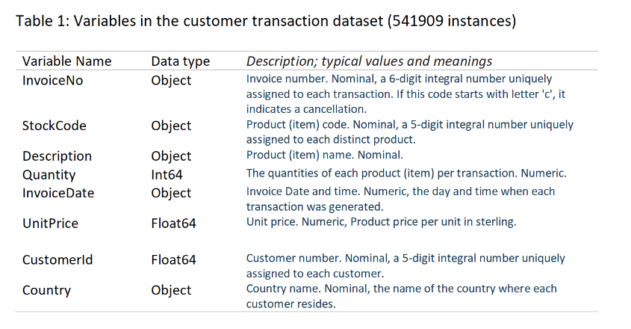
BRIEF DESCRIPTION OF THE DATA
This is a transnational data set that contains all the transactions occurring between 01/12/2010 and
09/12/2011 for a UK-based and registered non-store online retailer. The company mainly sells unique
all-occasion gifts. Many customers of the company are wholesalers.

Slide 7

Preprocessing of the data
Preprocessing data: The steps taken to transform raw data into a format that is suitable for analysis
Its a crucial step in data analysis and machine learning, as it helps to ensure that the data is of high quality and the model is able to learn meaningful patterns from the data.
The goal of preprocessing: To improve the quality of the data by removing any irrelevant or redundant information, dealing with missing values, transforming categorical variables into numerical ones, and handling outliers.

Slide 8

Continued…
The preprocessing steps may include:
Cleaning the data by removing errors or inconsistencies, such as duplicates or missing values. This can involve techniques such as imputation, dropping missing values, or filling in missing values using statistical methods.
Featuring engineering, which involves creating new features or transforming existing ones to improve the performance of the analysis. This can include scaling, normalization, or encoding categorical variables.
Splitting the data into training, validation, and testing sets, to ensure that the model is able to generalize well to new, unseen data.

Slide 9
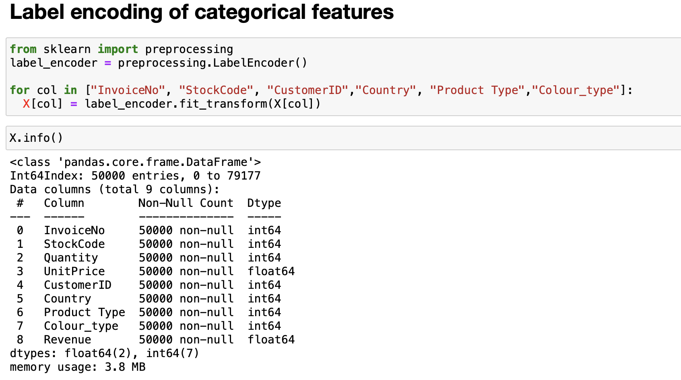
Label Encoding
LabelEncoder is a utility class that can be used to encode categorical data into numeric labels.
Each unique category in a feature is assigned a numerical label.

Slide 10
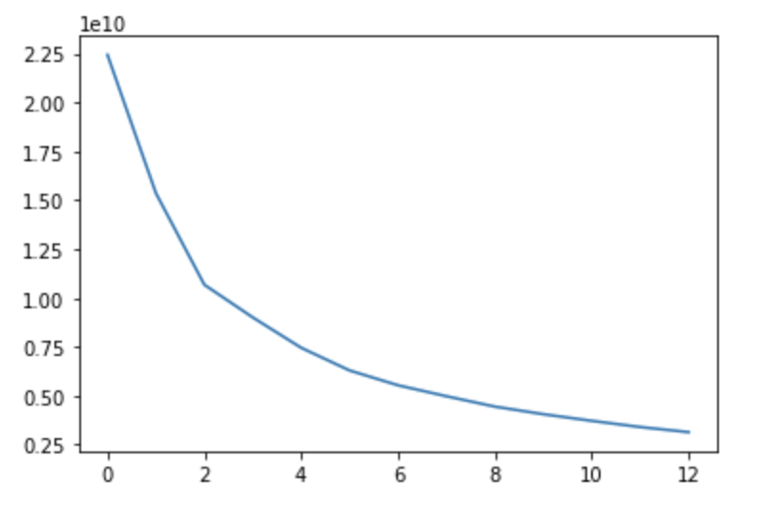
K-prototype Clustering
The KPrototypes algorithm is specifically designed to handle datasets that have a mixture of numerical and categorical data.
The cost represents the sum of the distances between each point and its assigned cluster center.
By plotting the cost for different values of num_clusters, you can visually inspect the "elbow" point in the plot, which can help you to determine the optimal number of clusters to use for your data.
Elbow Curve

Slide 11
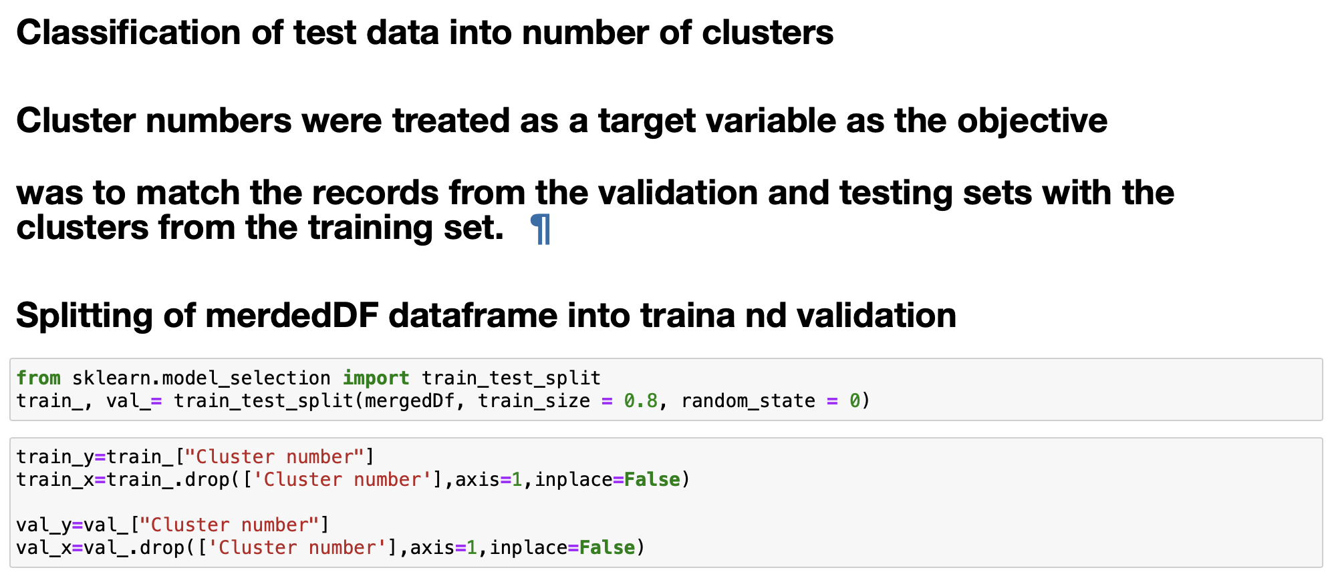
Classification of the clustering

Slide 12
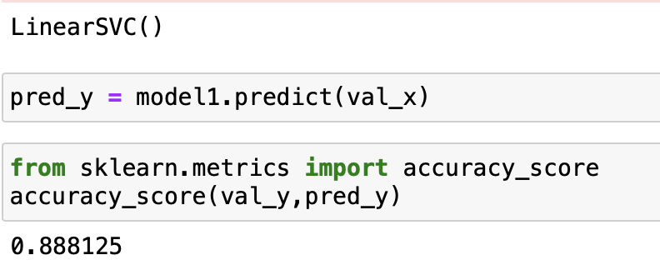
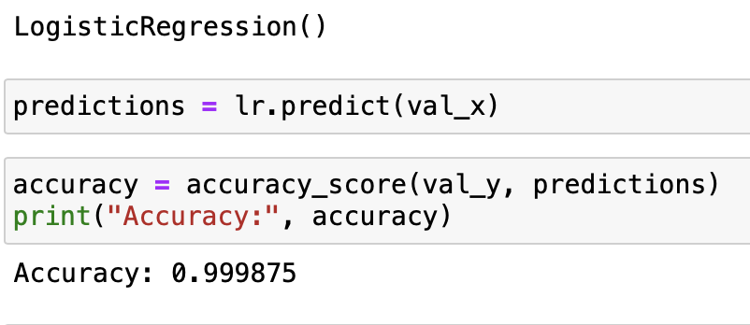
Accuracy of the Linear SVC Algorithm for the cluster classification
Accuracy of the Logistic Regression Algorithm for the cluster classification

Slide 13
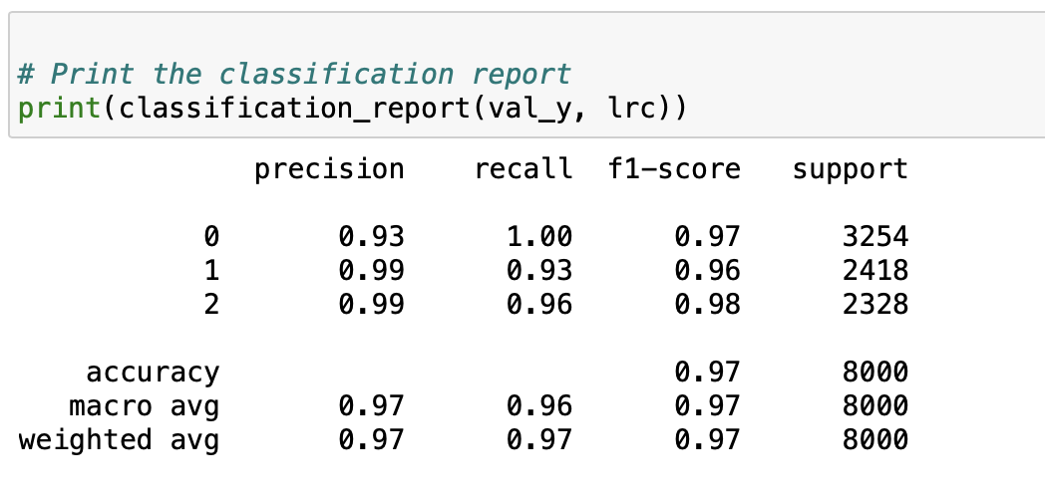
Classification Report
The classification report provides information on the precision, recall, and F1-score for each cluster as well as the overall accuracy.
Precision: Out of all the instances that were predicted as belonging to a cluster, what fraction actually belong to that cluster.
Recall: Out of all the instances that actually belong to a cluster, what fraction was correctly predicted to belong to that cluster.
F1-score: The harmonic mean of precision and recall.

Slide 14
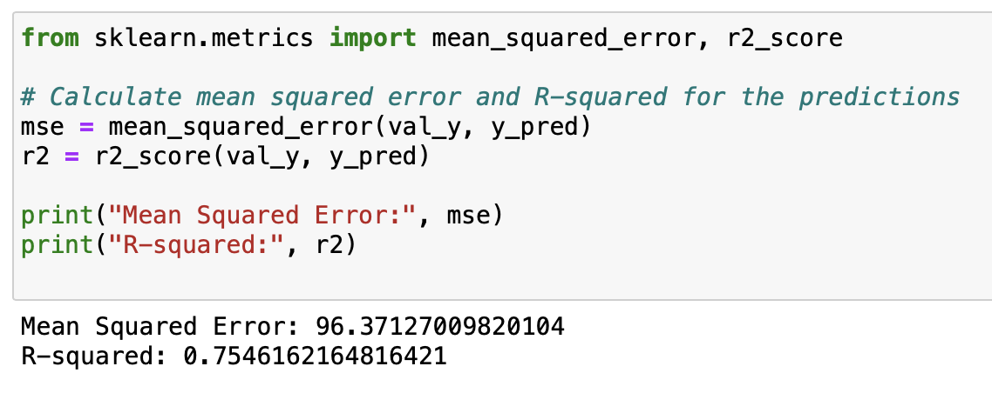
Prediction of Revenue based on the merged data
Random Forest Regressor
Here our target variable is continuous, such as a numerical value like sales revenue or temperature, you would need to use a regression algorithm instead of a classification algorithm.
For regression algorithms we calculate the mean squared error and R-squared score to evaluate the performance of the model.
The mean squared error measures the average squared difference between the predicted values and the actual values.
while the R-squared score measures the proportion of variance in the target variable that is explained by the independent variables.

Slide 15
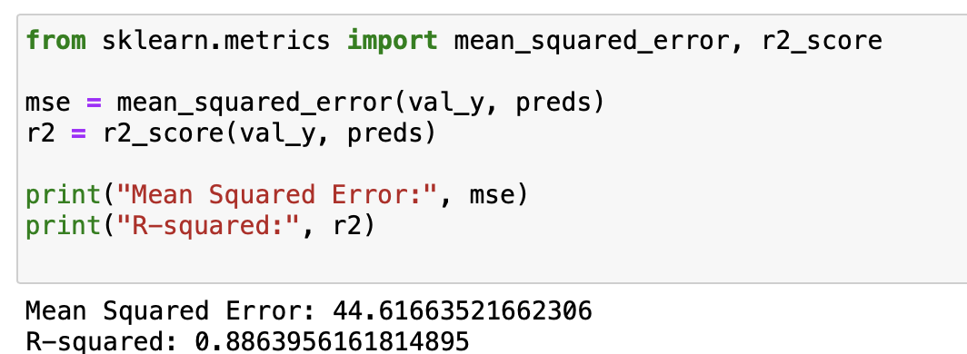
Gradient Boosting Regressor

Slide 16

Time Series Forecasting
It is a process of using historical data to predict future values.
It can be used for a variety of applications, such as sales forecasting, inventory management, and demand forecasting.
There are a variety of methods for time series forecasting, including simple moving averages, exponential smoothing, and SARIMAX models

Slide 17
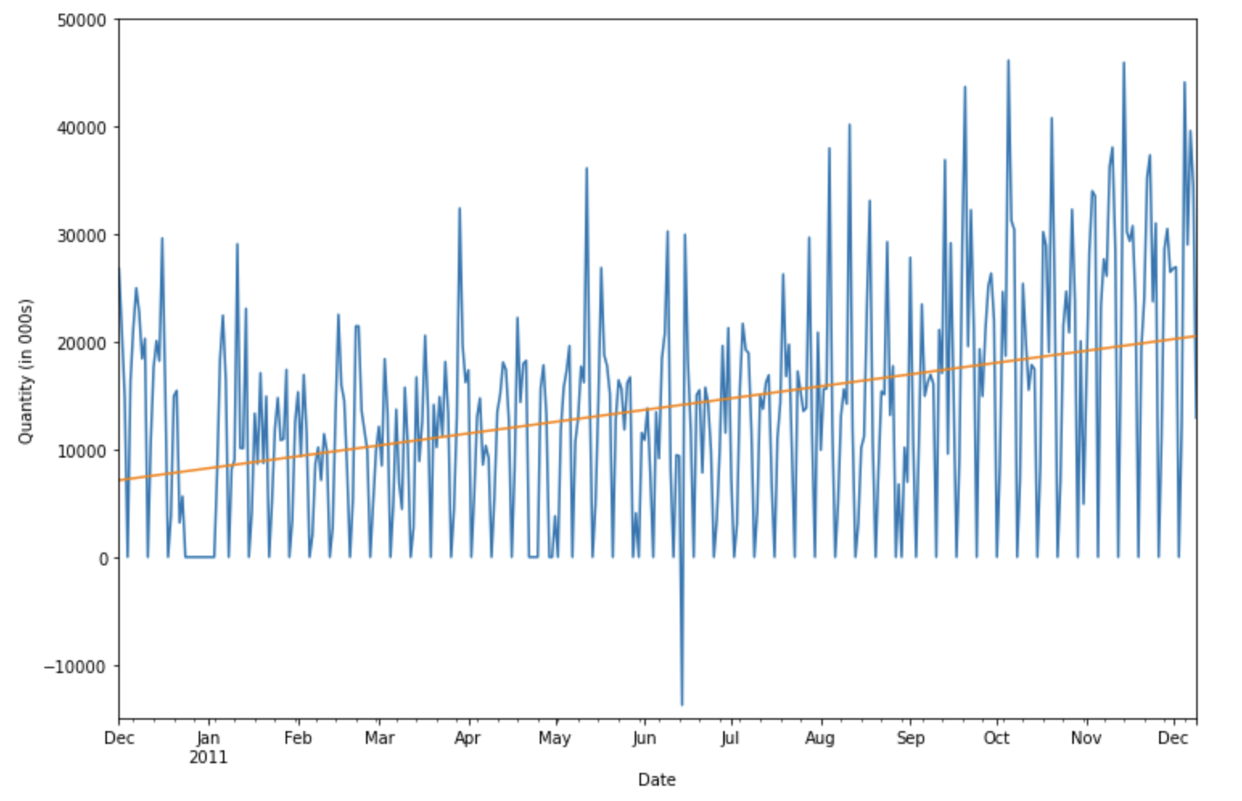
Fitting Trend
The figure shows a linear trend model fitted to a time series of monthly retail quantity data, revealing a positive and steady increase over time.
By adding a linear trend to the time series, the plot highlights the upward trend in retail quantity data over time, indicating potential long-term growth opportunities.

Slide 18
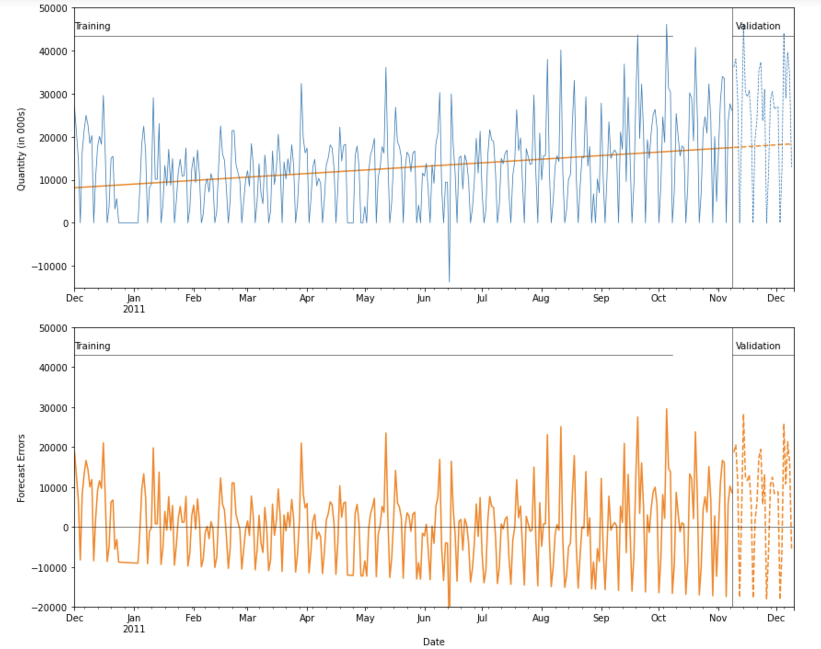
Linear Regression Model
The upper plot shows the actual values of the time series data as well as the linear trend predicted by the model.
The lower plot shows the forecast errors, which are the differences between the actual values and the predicted values of the model
The linear regression model used in this analysis helps to capture the overall trend in the data and provides a useful framework for making predictions about future sales.

Slide 19
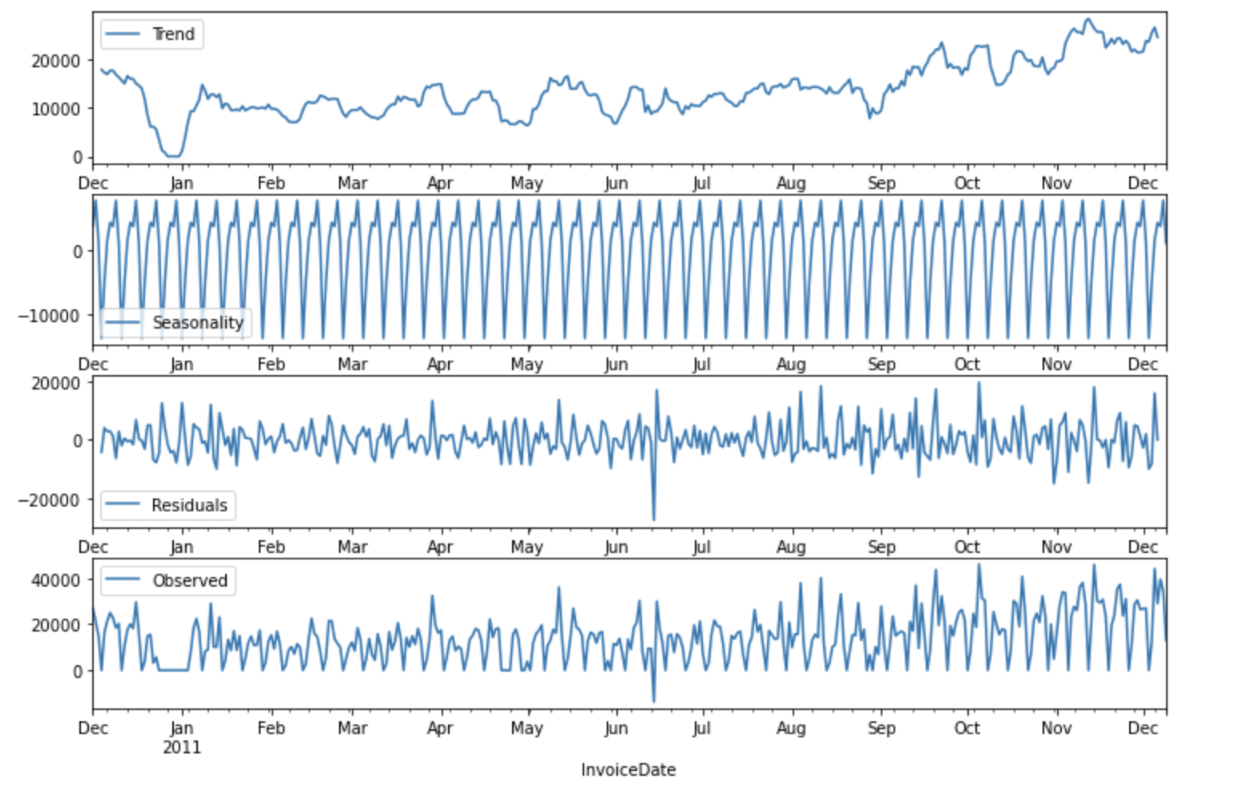
Seasonal Decomposition Plot
Trend component represents the long-term changes in the series and can be used to identify overall patterns or trends over time.
Seasonal component represents regular, repeating patterns or cycles in the series, such as monthly.
The residual component represents the random pattern observed component represents the original time series data

Slide 20
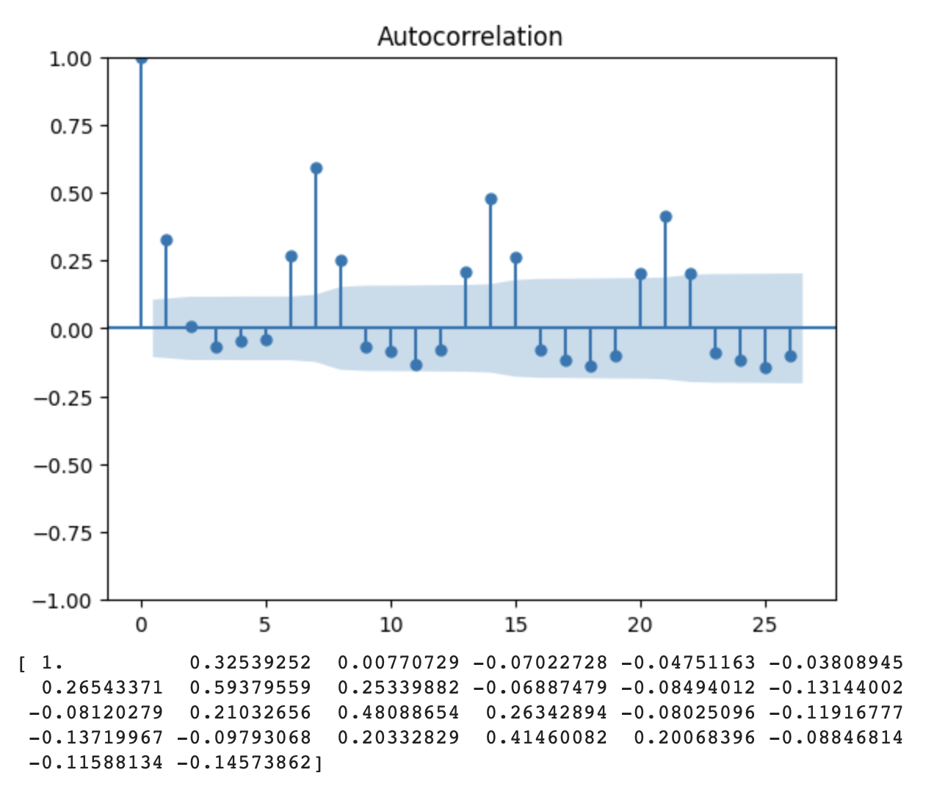
AutoCorrelation function (ACF)
ACF is a measure of the correlation between a time series and a lagged version of itself. It helps in identifying any patterns or trends in the data that are repeated over time.

Slide 21
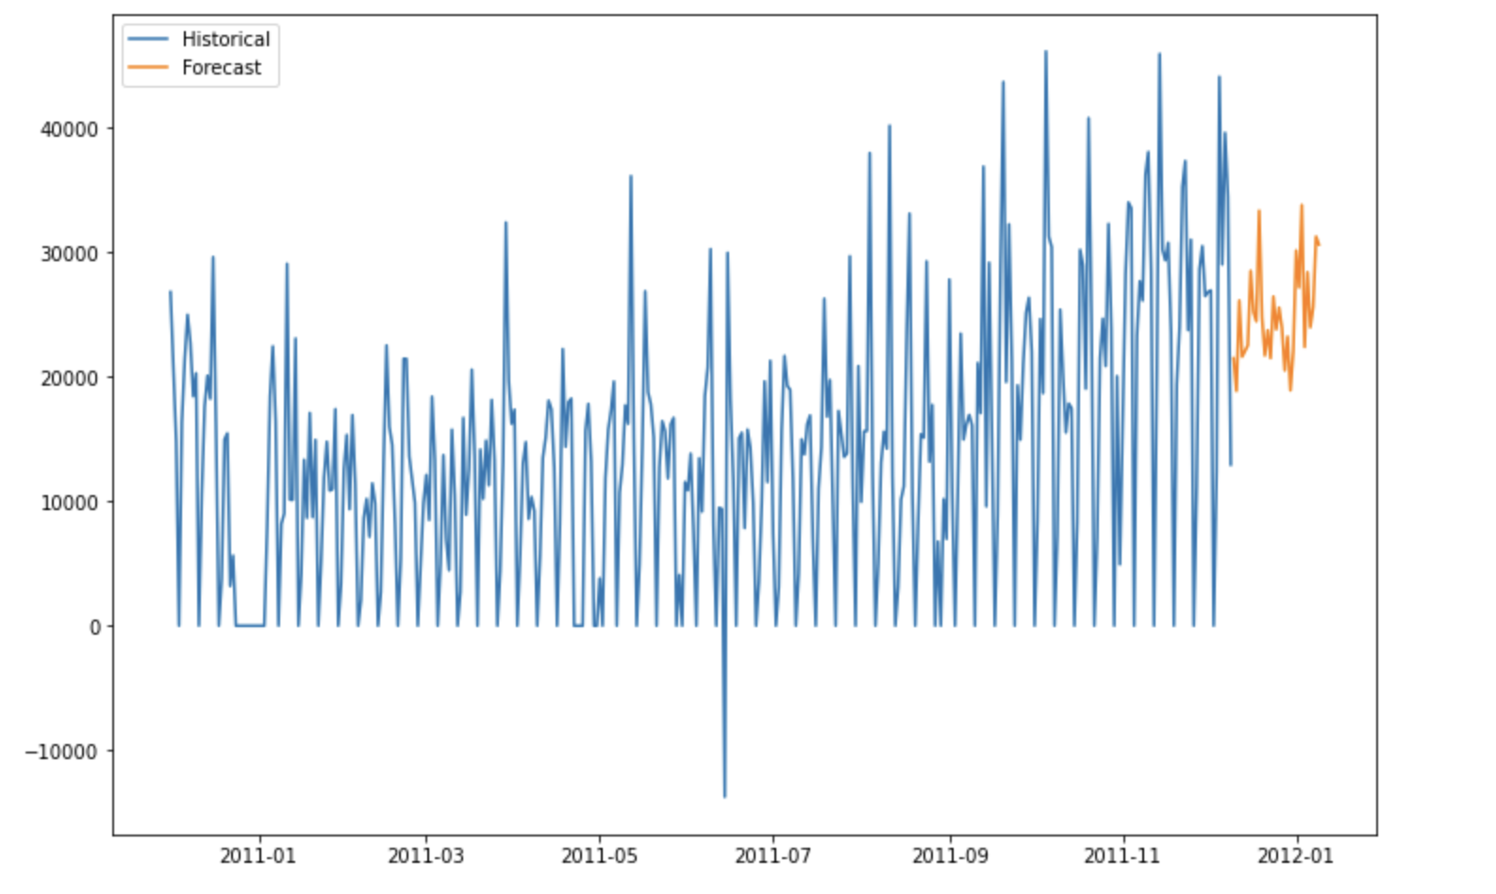
SRIMAX Model
SARIMAX is a popular time series modeling technique that can handle seasonality and trends in the data.
In this we split the data into training and test sets, train the SARIMAX model on the training data.
By training the SARIMAX model on historical sales data, it can generate forecasts for future periods. These forecasts can be useful for inventory planning and sales projections.

Slide 22
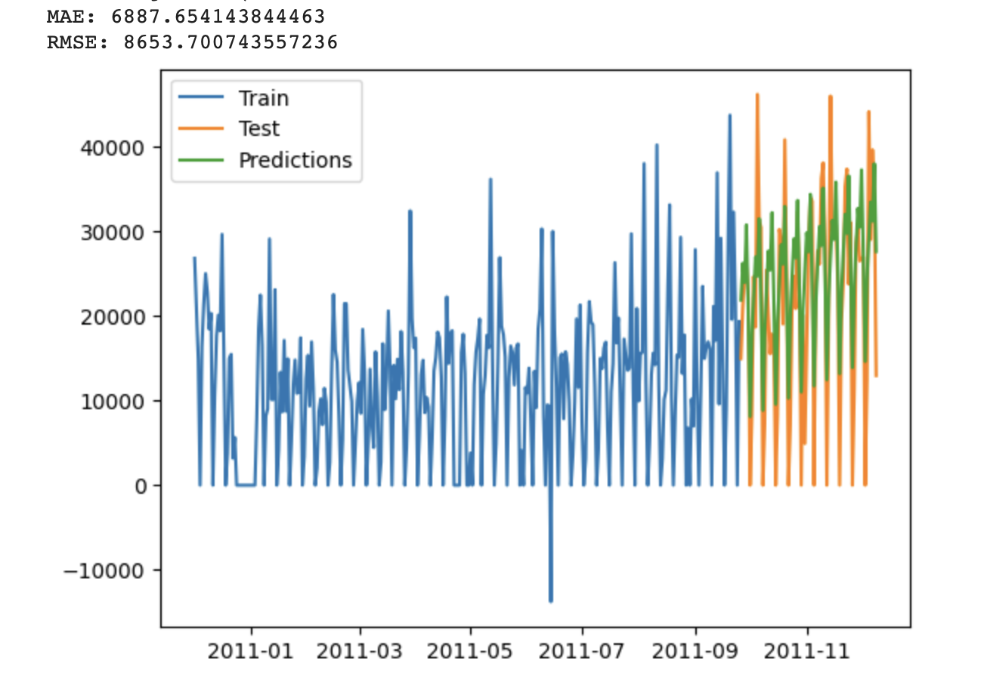
Exponential Smoothing
The model have captured the trend and seasonality of the data well, as the predicted values follow the same pattern as the actual data.
However, the model appears to struggle with capturing the sudden peaks and drops in the test data, as there are some significant deviations between the predicted and actual values in certain periods.
Both the MAE and RMSE assessment scores were relatively low compared to SRIMAX, showing that the model is capable of producing reliable predictions.

Slide 23
Conclusion
In this project, we applied K-prototype clustering to identify distinct clusters based on both categorical and numerical features. We used linear SVC, KNN, and logistic regression to classify the clusters, achieving an accuracy score of 0.97 in the classification report of logistic regression.
We also explored Random Forest Regression and Gradient Boosting Regression to predict the target variable (revenue) and found that Gradient Boosting Regression had the best performance.
Holt-Winters approach-based Exponential Smoothing method is an effective way for predicting sales data. 80% of the dataset was used to train the model, while the remaining 20% was used to test it. Both the MAE and RMSE assessment scores were relatively low, showing that the model is capable of producing reliable predictions. Overall, the Exponential Smoothing method can be a powerful tool for time series forecasting, especially when applied to online retail sales data.
While our results were promising, further research could be done to explore other models and feature selection techniques to further improve performance.

Slide 24

Thank you

